Slide 1

2.0 Form Development using
Configuration Tool
&
Deployment
August 2022
Confidential to Selfservit Solutions

Slide 2
Overview
Pre requisites for 2.0 App Website and CVS folder
CVS mapping
Files in website
Form development methodology flow
Preparing Excel
Define feature_id Screen_id
CVS files and procedure naming structure

Slide 3
Overview
Tables
Company Feature
Package Feature
Company Feature Group Id Link
Company Feature Access Order
Functional Access Profile

Slide 4
Overview
CVS files using Configuration tool
Controller
UI
Label
Rule
Template
Other configurations
Procedures
sp_retrieve_manage_custom_info_list_my_calls
sp_save_manage_custom_info_screenid
sp_save_manage_custom_info_digital_report
Queue file structure

Slide 5
CVS mapping
1. check cvs/temp_encrypted/ check the access_package_client_id_country_code_timestamp.ZIP and configuration_package_client_id_country_code_timestamp.ZIP available with latest timestamp
If not available not connected to correct CVS path
2. Update timestamp in auth_indication_com.selfservit.mservice_Android_GooglePlayStore same as configuration_package
3. CVS/client_list.xml
<indirect>
<in>
<cvs_protocol_type>https</cvs_protocol_type>
<cvs_domain_name>indirect.mservice.net</cvs_domain_name>
<cvs_port_no>90</cvs_port_no>
</in>
</indirect>
Add CVS server IP in Environment server client_list.xml and make sure CVS folder is mapped correctly.

Slide 6
Prerequisite Files
/common/components/containR/CreateDigitalreport.aspx
fn_get_client_specific_fields_for_my_calls

Slide 7
Form development methodology flow
E Excel Inputs (Refer sample in next slide)
Capture Forms requirement with existing output
define feature_id, screen_id
Prepare Excel Sheet and note all the fields required in the form
Mark rules for the fields like mandatory / setting up min/max drop down values and any other rules
Mark the field as auto fill (fetch from DB) or manual fill
Mark type of field like Text box / Combo box/ drop down / mloop / numerical box etc
Testing of UI form and review the output by running test cases
For fields to be retrieved from DB, update the relevant procedures and set the rule (Refer database section)
Development of template files based on the requirement for PDF output.
Get trained on using Configuration tool to develop forms - set the label, UI, rule and controller files (Refer config tools section)
Insert data in relevant tables for adding form features and setting up work flow (Refer Tables section)
Prepare the test cases for UI form and PDF output

Slide 8
Preparing Excel
Preparing excel with all fields required in form.
Define field-id, widget type, auto fill from DB, manual fill, rules ( mandatory, field validation for manual entry fields, min-max values,and other rules), drop down values
field_id can be defined with min length. We can even go with field_1, field_2 etc, if the fields are less in number and only using to display values in PDF.
If data fetching from DB OR data saving to the DB, keep the DB column name as field_id.

Slide 9
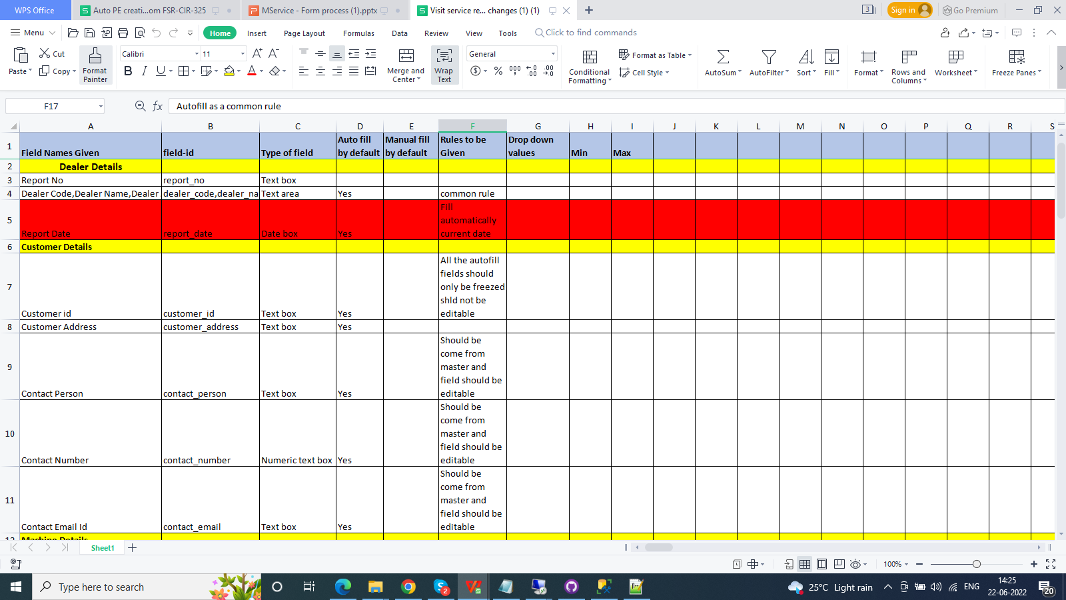
Sample Excel input

Slide 10
Feature_id and screen_id
feature_id='MMILKING' max 15 characters, mobile feature_id need to prefix with M
screen_id ='milking_system_form' max 60 chars allowed
form name = milking_form ; will be coming as form attachment name
Feature_id dependency on the following tables:
select * from company_feature
select * from company_feature_access_order where (next_feature_id='MMILKING' OR current_feature_id='MMILKING')
select * from package_feature where feature_id='MMILKING'
select * from company_feature_group_id_link where ( parent_feature_group='MMILKING' or child_feature_id_or_group= 'MMILKING')
select * from functional_access_profile where feature_access=1 and feature_id='MMILKING'

Slide 11
CVS files and Procedure naming structure
my_service_call is the screen_id for service call screen in app [feature_id=MHMMYSERVCALL, screen_id=my_service_call]
my_service_call_MMILKING is the screen_id defined as property of Controller
ui_my_service_call_MMILKING_delaval_in
label_my_service_call_MMILKING_delaval_in_en-us
controller_my_service_call_MMILKING_delaval_in
rule_my_service_call_MMILKING_delaval_in
my_service_call_MMILKING_template_delaval_in
sp_retrieve_manage_custom_info_list_my_calls
sp_save_manage_custom_info_milking_system_form_delaval_in OR sp_save_manage_custom_info_milking_system_form [ info code is the screen_id from company_feature table]
sp_save_manage_custom_info_ my_service_call_MMILKING
sp_save_manage_custom_info_digital_report
sp_save_manage_custom_info_call_status_change_se- Proc to update status change

Slide 12
Company Feature
company_feature is a table, where we need to define feature_id column which is a primary key column.
feature_id, feature_name, feature_display_label and screen_id defining here.feature_id and screen_id need not be same
Insert Record of company_feature table
Eg.;
INSERT [dbo].[company_feature] ([company_id], [country_code], [feature_id], [feature_name], [feature_display_label], [program_reference], [menu_display_ind], [screen_id], [channel_id], [last_update_id]) VALUES (N'delaval', N'in', N'SERVICEREPORT', N'Service Report', N'Service Report', N'NULL', 0, N'service_report_form', N'mobile', N'system')

Slide 13
Package Feature
package_feature table package_id, module_id, feature_id is a primary key column.
feature_id should be same as company_feature table.
package_id same as in company_subscription matrix.Insert Record of company_feature table.
Eg.;
INSERT [dbo].[package_feature] ([package_id], [module_id], [feature_id], [last_update_id]) VALUES (N'FCMPROFESSIONAL', N'DOUBLEO', N'SERVICEREPORT', N'system')

Slide 14
Company Feature Group Id Link
company_feature_group_id_link table parent_feature_group, child_feature_id_or_group is a primary key column.
Insert record for company_feature_group_id_link
Eg:-
INSERT [dbo].[company_feature_group_id_link] ([company_id], [country_code], [parent_feature_group], [child_feature_id_or_group], [child_feature_id_or_group_ind], [parent_level_no], [parent_display_order], [child_level_no], [child_display_order], [last_update_id]) VALUES (N'delaval', N'in', N'WORKFLOW', N'SERVICEREPORT', N'F', 0, 1, 0, 1, N'system')

Slide 15
Company feature access order
company_feature_access_order table has primary key like
transaction_type_code - it will be ‘CALL’ for call flow
request_category - Will be the call category, SE(service), PE(parts sale),SA(equipment sale)
request_type - will be the call type, if the flow need t define according to call_type
request_wf_stage_no - Workflow stage no will be defined here (workflow_stage master table )
request_wf_status - Workflow status
current_feature_id - feature id defined in company_feature table, package_feature and mapped to package Id in company_subscription table
next_feature_id - feature id defined in company_feature table, package_feature and mapped to package Id in company_subscription table

Slide 16
Setting up workflow - Company feature access order
In this table we need to define the flow in the mobile based on current feature id and next feature id.
Sample current feature and next feature for the call flow with example
Requirement: Trip start --> Trip Finish --> Work Start --> Work Finish --> Form --> Call complete
Current Feature | Next Feature
MTRIPSTART | MTRIPFINISH
MTRIPFINISH | MCALSTART
MCALSTART | MCALFINISH
MCALFINISH | REPORT
REPORT | MCALCOMPLETE

Slide 17
Setting up workflow- Company feature access order
Sample insert script for company_feature_access_order
INSERT [dbo].[company_feature_access_order] ([company_id], [country_code], [transaction_type_code], [request_category], [request_type], [request_wf_stage_no], [request_wf_status], [current_feature_id], [next_feature_id], [last_update_id]) VALUES (N'delaval', N'in', N'CALL', N'SE', N'ALL', 0, N'ALL', N'MTRIPSTART', N'MTRIPFINISH', N'system')
INSERT [dbo].[company_feature_access_order] ([company_id], [country_code], [transaction_type_code], [request_category], [request_type], [request_wf_stage_no], [request_wf_status], [current_feature_id], [next_feature_id], [last_update_id]) VALUES (N'delaval', N'in', N'CALL', N'SE', N'ALL', 0, N'ALL', N'MTRIPFINISH', N'MCALSTART', N'system')
INSERT [dbo].[company_feature_access_order] ([company_id], [country_code], [transaction_type_code], [request_category], [request_type], [request_wf_stage_no], [request_wf_status], [current_feature_id], [next_feature_id], [last_update_id]) VALUES (N'delaval', N'in', N'CALL', N'SE', N'ALL', 0, N'ALL', N'MCALSTART', N'MCALFINISH',N'system')

Slide 18
Setting up workflow- Company feature access order
INSERT [dbo].[company_feature_access_order] ([company_id], [country_code], [transaction_type_code], [request_category], [request_type], [request_wf_stage_no], [request_wf_status], [current_feature_id], [next_feature_id], [last_update_id]) VALUES (N'delaval', N'in', N'CALL', N'SE', N'ALL', 0, N'ALL', N'MCALFINISH', N'SERVICEREPORT', N'system')
INSERT [dbo].[company_feature_access_order] ([company_id], [country_code], [transaction_type_code], [request_category], [request_type], [request_wf_stage_no], [request_wf_status], [current_feature_id], [next_feature_id], [last_update_id]) VALUES (N'delaval', N'in', N'CALL', N'SE', N'ALL', 0, N'ALL', N'SERVICEREPORT', N'MCALCOMPLETE', N'system')

Slide 19
Functional Access Profile
Feature access to be given to the respective user_group
INSERT INTO [dbo].[functional_access_profile] ([company_id], [country_code], [user_group_id], [feature_id] ,[feature_access], [add_access], [edit_access], [view_access], [delete_access], [export_access], [print_access], [import_access], [last_update_id]) VALUES (N'delaval', N'in', N'DLR_SENGG',N'SERVICEREPORT', 1,0,0,0,0,0,0,0,N'system')

Slide 20
Configuration Tool
Update Database tables and create procedures
Develop form files using configuration tool.
UI, LABEL, RULE, CONTROLLER, TEMPLATE can be developed with the help of tool.

Slide 21
Configuration Tool - Format of UI file
The format of UI file
ui_screenid_clientid_countrycode [screen_id defined in controller]
Eg:
ui_my_service_call_SERVICEREPORT_delaval_in
Folder path:
\CVS\configuration_package\clientid\countrycode\ui

Slide 22
Configuration Tool - Format of Label file
The format of LABEL file
label_screenid_clientid_countrycode_localeid [screen_id defined in controller]
Eg:
label_my_service_call_SERVICEREPORT_delaval_in_en-us
Folder path:
\CVS\configuration_package\clientid\countrycode\label

Slide 23
Configuration Tool - Format of controller file
The format of CONTROLLER file
controller_screenid_clientid_countrycode [screen_id defined in controller]
Eg:
controller_my_service_call_SERVICEREPORT_delaval_in
Folder path:
\CVS\configuration_package\clientid\countrycode\controller

Slide 24
Configuration Tool - Format of Rule file
The format for RULE file is
rule_screenid_clientid_countrycode [screen_id defined in controller]
Eg:
rule_my_service_call_SERVICEREPORT_delaval_in
Folder path:
\CVS\configuration_package\clientid\countrycode\rule

Slide 25
Template file creation
The template file should be developed manually using HTML and values will be binding through KENDO.
The format for template file is
screenID_template_clientid_countrycode [screen_id defined in controller]
Eg: my_service_call_SERVICEREPORT_template_delaval_in
Folder path:
\CVS\configuration_package\clientid\countrycode\template
HTML template will be passed as queue file to server for PDF generation in server. server side template file not required.

Slide 26
Configuration Tool - Properties of Controller file
1. What is ScreenId ? my_service_call_featureID ( this screen id not same as the screen_id in the company_feature table ).Provide same as file name in controller.
2. What is clientIdName ? as defined
3. What are the countryCodeNames ? in, vn , bd
4. What is the ViewType ?ContainR
5. What is the View SubType ? Form
6.Do your want this screen in HomeTab ? No. Required yes, for screen_id having menu_display_ind =1
7.What is ContainR Type? Form
8. What is ContainR SubType? workflow.
9. Do you have the DigitalReport? true

Slide 27
Configuration Tool - Format of controller file
10. What is Transaction Number - #: mService.containR.variable. my_service_call_featureID.selectedRecord.call_no #
11. What is FormName - #: mService.app.getUserId() #_#: kendo.toString(new Date(), 'ddMMyy') #_#: 'form_name' #
Form name not dependant on either screen_id or feature_id. Form name is attachment name in web attachment tab. It should be customer friendly name
12.What is attachmentPathKey- ATTACHMENT_PATH_CACHE
13.Do you want to have Draft Saving? true
14. What is infoCode? - screen_id from company_feature_access table
15. What is allow new transaction - True
16. What is modify last transaction - True

Slide 28
Other Configurations...
In, label_my_service_call_clientid_countrycode_localeid file under “wFlowEvents” we need to give label for our feature_id in order to display the label of our form in the workflow icon.
Folder path:
\CVS\configuration_package\clientid\countrycode\label
In, mobile.fonts.reference_clientid_countrycode file under “my_actions” we need to specify icon symbol for the feature id.
Folder path:
\CVS\configuration_package\clientid\countrycode\fonts\js

Slide 29
Data base procedures
While loading of a form, the following procedure will be called.
sp_retrieve_manage_custom_info_list_my_calls
We can also apply rule to set a value of the field from the back end.
Eg:-
APPLY [SetValue] ON [#my_service_call_SERVICEREPORT_site_in_charge_email] VALUE [$mService.containR.variable.my_service_call_SERVICEREPORT.selectedRecord.cust_contact_email_id];
this “cust_contact_email_id” will be defined in the sp_retrieve_manage_custom_info_list_my_calls procedure.
fn_get_client_specific_fields_for_my_calls is using to get client specific fields.

Slide 30
Data base procedures
After submission of a form
sp_save_manage_custom_info_info_code_clientid_countrycode
or
sp_save_manage_custom_info_info_code
procedure will be triggered, from their we are executing
sp_save_manage_custom_info_digital_report
where in this procedure, we are defining form attachment and call flow for a specific call.
Finally our form PDF will be reflected in web for a specific call.
1. Create procedure sp_save_manage_custom_info_info_code_clientid_countrycode
2. update screen_id
3.

Slide 31
Queue Files, generated while submit form
The queue files execute as follows
/common/components/containR/CreateDigitalreport.aspx - input json data
/common/components/containR/CreateDigitalreport.aspx - HTML template to generate PDF in server side
/api/common_modules/save_manage_custom_info","key":"my_service_call_SERVICEREPORT" - used to save data to server. The fields having saveField= true, only sent to server for saving in database. Key is the form name

Slide 32
THANK YOU

